Slide 1
8 Classic Structure
of Storytelling

Slide 2
1.Introduction or Exposition ( Prologue )
To inform the basic idea of Characters, Period, Place and etc.
To draw in the audience attention.
The author might give a hint of conflict in this section.

Slide 3
2.Conflict, Complication and Rising Action ( Interlude )
Storytelling is based on conflict. Without conflict there’s no drama. Drama is conflict.

Slide 4
3. Crisis to Climax
This crisis is part of the knot. The tension of the story can happen many times, so the crisis in each story can happen more than once. However When the story reaches the tensions of the story, it causes the final refraction before the matter is resolved and ended. It is often called the climax, which is the most tension moment of the story. And the last point of the knot.
Climax
The most important or exciting point in a story or situation, especially this happen near the end.
The highest point of sexual pleasure. (cambridge dic.)

Slide 5
4. Falling Action (epilogue)
It's a process of tension reducing. Eventually, This will lead to the solution of the problem and conflicts.

Slide 6
5. Resolution / Denouement

Slide 7
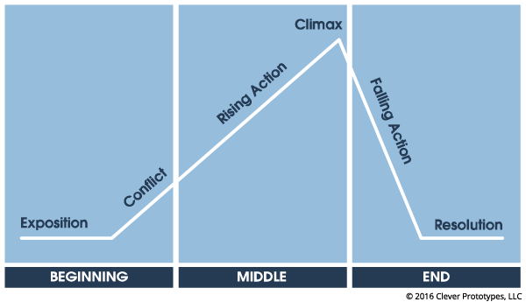
Three Act Story Structure.

Slide 8
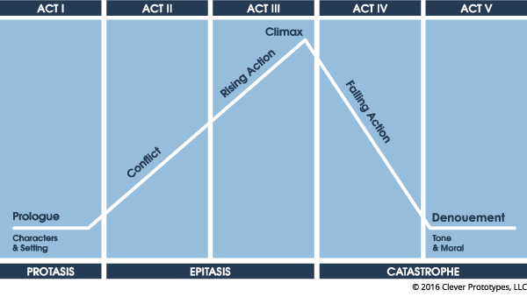
Five Act Play

Slide 9
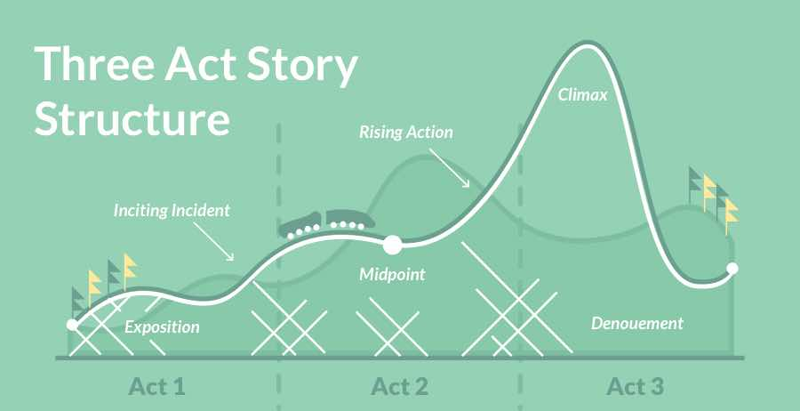

Slide 10
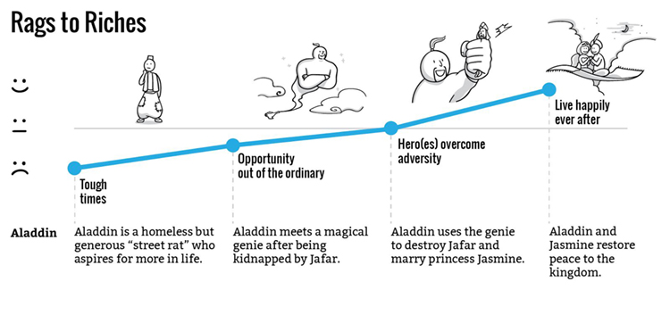

Slide 11
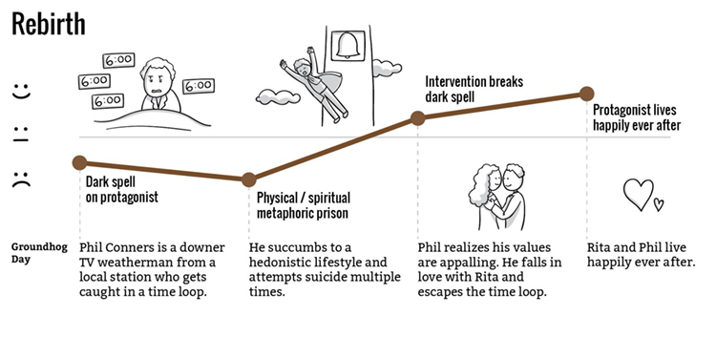

Slide 12
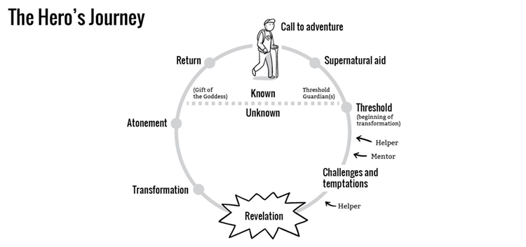

Slide 13
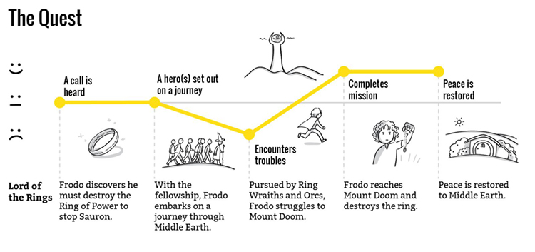

Slide 14
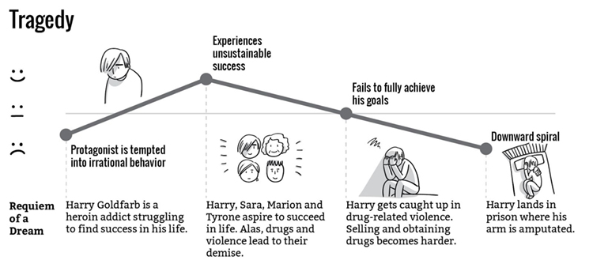

Slide 15
- http://blog.bookbaby.com/2017/07/narrative-structure-what-it-is-how-to-use-it/
- http://ingridsundberg.com/2013/06/05/what-is-arch-plot-and-classic-design/
- https://www.presentation-guru.com/on-structure-the-hidden-framework-that-hangs-your-story-together/
- https://www.scriptmag.com/features/conflict-the-foundation-of-storytelling
- https://www.storyboardthat.com/articles/e/narrative-structures

