Slide 1
montage
From oxford dictionary
noun
[MASS NOUN]
1. The technique of selecting, editing, and piecing together separate sections of film to form a continuous whole.
1.1 [COUNT NOUN] A sequence of film made using the technique of montage
1.2 The technique of producing a new composite whole from fragments of pictures, text, or music

Slide 2


Slide 3
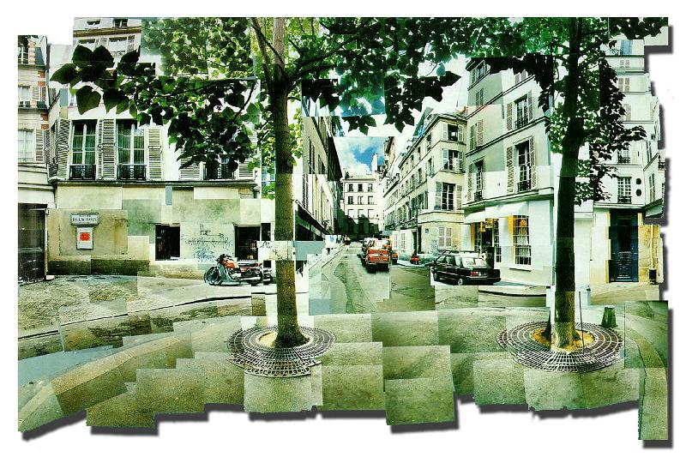

Slide 4
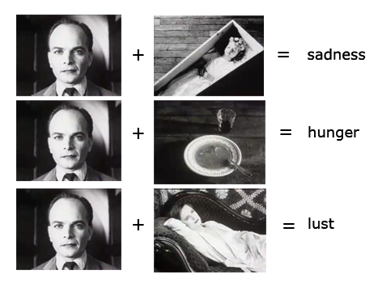

Slide 5
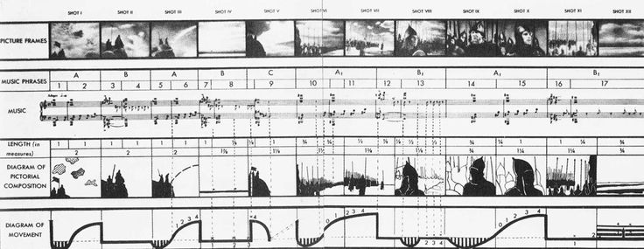

Slide 6
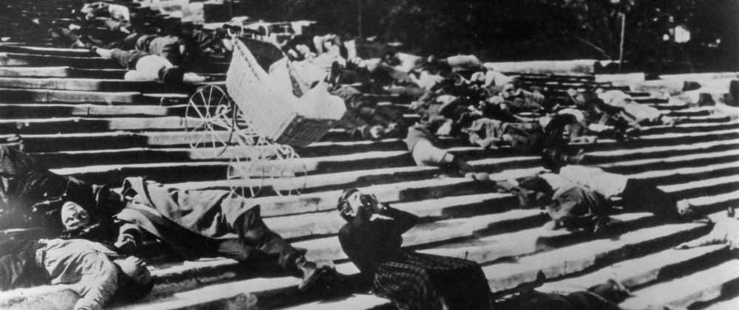

Slide 7
collage
From oxford dictionary
noun
1. A piece of art made by sticking various different materials such as photographs and pieces of paper or fabric on to a backing.

Slide 8


Slide 9
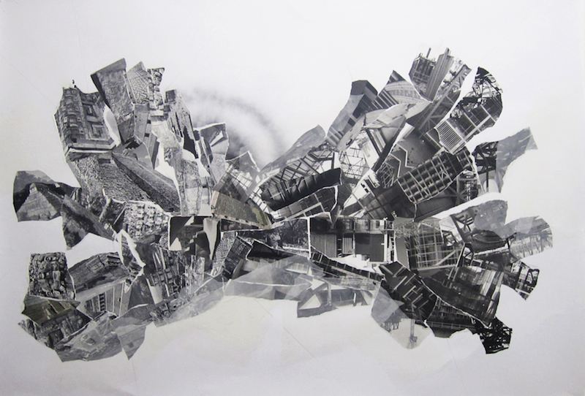

Slide 10


Slide 11
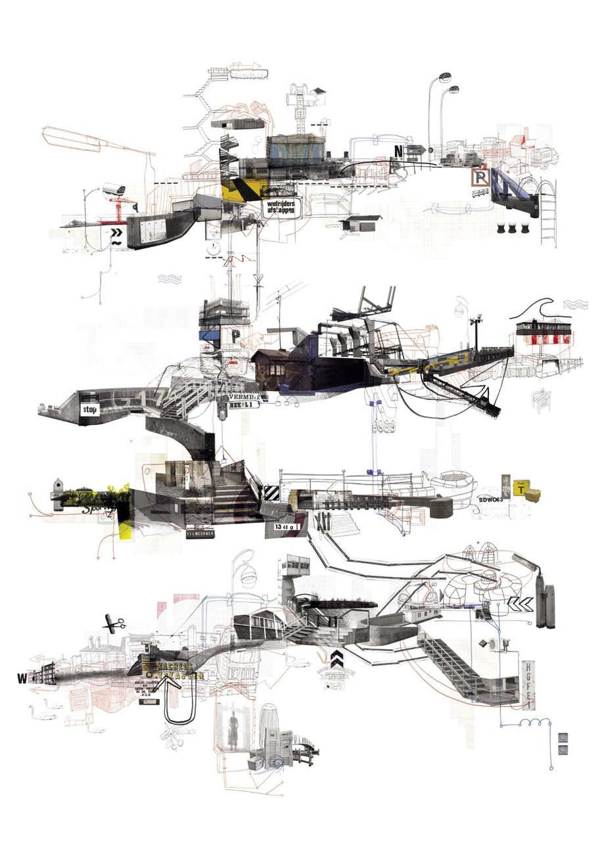

Slide 12
